Slide 1











Visualize’26 24hr Hackathon
BOOK BRIDGE
PS ID:
VH26-AI-07
PS Title:
Student Innovation
Theme:
Agentic AI
Team Name:
Visionary Squad
Team Members:
3

Slide 2
ABSTRACT
Access to books in residential communities and small libraries is often limited due to manual coordination and poor digital visibility.
BOOKBRIDGE is proposed as a community-based mobile application for peer-to-peer book sharing.
Users will be able to list their books, browse available books, and request to borrow them within their community.
The system will include administrative control with super admin and community-level admins.
n8n will be used to automate email notifications when a new book is added to the community.
The project aims to improve accessibility, transparency, and efficiency in community book sharing.
01

Slide 3
PROBLEM STATEMENT
In most gated communities, there is no dedicated platform for residents to share or borrow books efficiently.
As a result, personal book collections remain underutilized, and opportunities for knowledge exchange are lost.
Existing online book platforms are either public or commercial, lacking the privacy and trust required in a community setting.
There is also a need for a secure system that can verify uploaded book images using AI to prevent inappropriate or vulnerable content.
Hence, a community-based digital solution is required to make book sharing safe, simple, and effective.
02

Slide 4
EXISTING SOLUTION
Many existing book sharing platforms expose book owner details publicly, which can lead to privacy and security concerns.
Most systems lack AI-based verification to check book content during uploads.
Due to the absence of content filtering, children may access inappropriate or vulnerable book content.
03

Slide 5
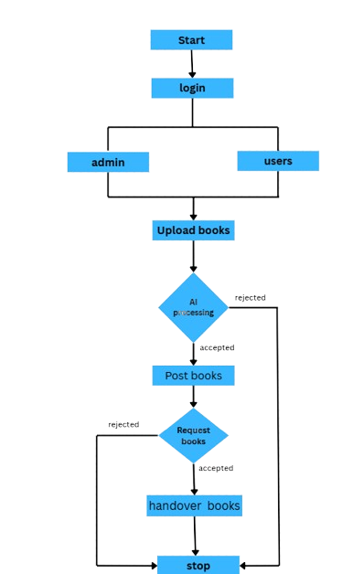
PROPOSED SOLUTION
To develop a secure mobile app for book sharing within gated communities, allowing access only to authorized members.
To Implement admin-controlled community management to handle users and monitor activities.
To Enable users to upload books and browse collections shared within their community.
To Provide a structured book request workflow where users can request books and owners can accept or decline the request.
To Ensure privacy protection by revealing the book owner’s contact details only after the request is accepted.
Integrate AI-based image verification to check uploaded book covers and prevent inappropriate or vulnerable content from being shared.
To use n8n to automate email notifications when new books are added.
04

Slide 6
MARKET ANALYSIS
The online book services market is rapidly growing, expected to reach about $26–27 billion by 2026 due to increasing internet and smartphone usage.
The system has potential to expand to multiple communities, schools, and residential societies in the future.
Many households own unused books that remain idle, creating an opportunity for a book-sharing ecosystem.
.
05

Slide 7
SDG ALIGNMENTS
Quality Education (SDG 4)
Encourages reading habits and knowledge sharing by making books easily accessible within the community.
Sustainable Cities and Communities (SDG 11)
Promotes community collaboration and resource sharing among residents in gated communities.
Responsible Consumption and Production (SDG 12)
Encourages reuse and sharing of books, reducing unnecessary purchases and promoting sustainable resource usage.
Reduced Inequalities (SDG 10)
Provides equal access to books and learning resources for all residents in the community.
06

Slide 8
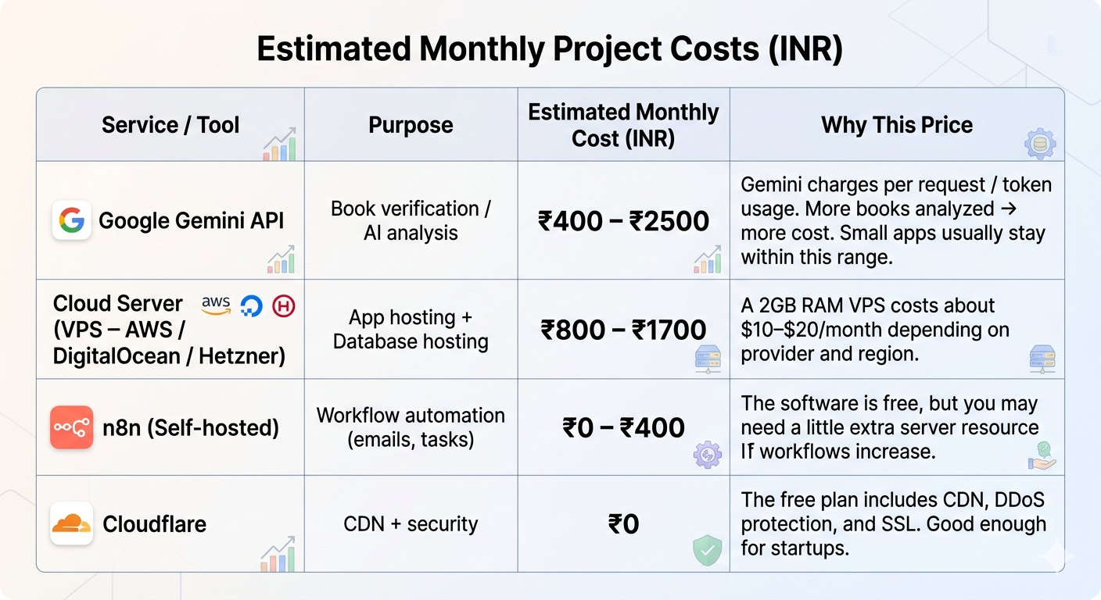
FINANCIAL ESTIMATION
07

Slide 9
CONCLUSION
BOOKBRIGE aims to create a secure and efficient platform for sharing books within gated communities.
The system simplifies the process of discovering, requesting, and lending books among residents.
Features such as admin-controlled access, AI-based verification, and automated notifications improve security and reliability.
By encouraging book reuse and community interaction, the platform promotes reading habits and collaborative learning.
Overall, the proposed solution helps build a connected, sustainable, and knowledge-sharing community environment.
08

Slide 10
REFERENCES
(PDF) Design and Development of a Digital Platform for Peer -to -Peer Book Exchange
Book-Share (BS) Apps using the Android System | Semantic Scholar
[PDF] Design and Implementation of Book Sharing System | Semantic Scholar
Hybrid Development in Flutter and its Widgits | Semantic Scholar
09

